Slide 1
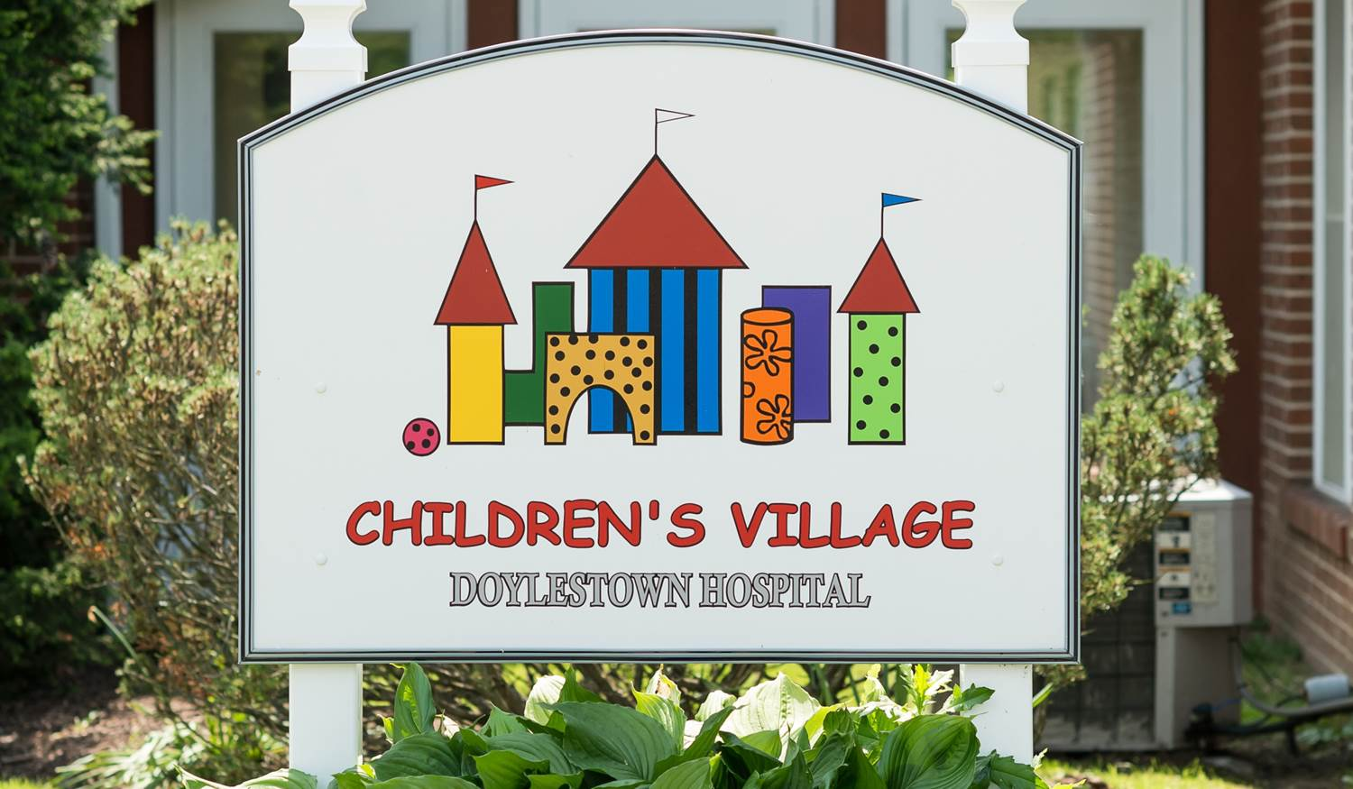
Welcome to Children’s Village! A safe, full-service, licensed and nationally accredited early
childhood educational facility with programs for babies and young children.

Slide 2
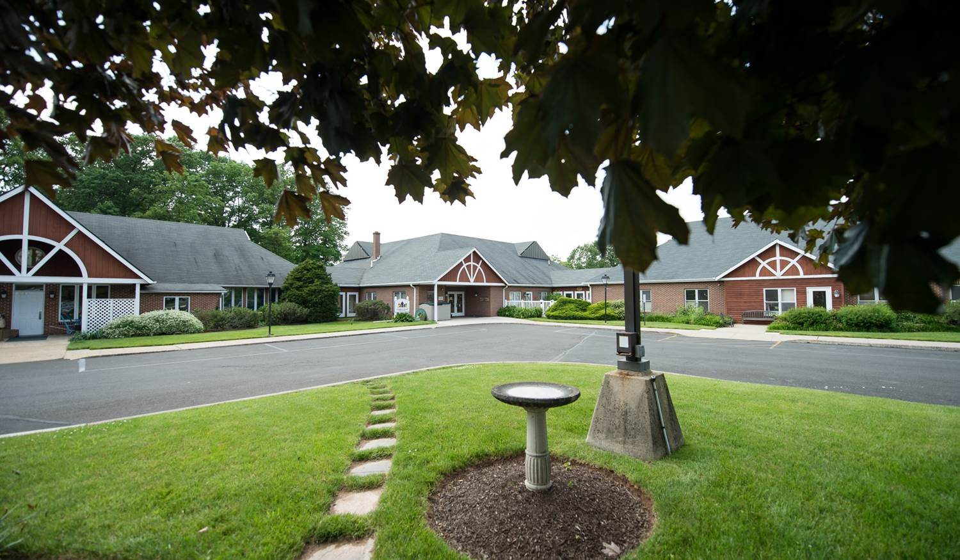
The center is conveniently located on Doylestown Hospital's campus and enrollment is open to the community. We offer custom scheduling with extended hours including early drop-off and late pickup from 6:15 am to 6:30 pm.

Slide 3
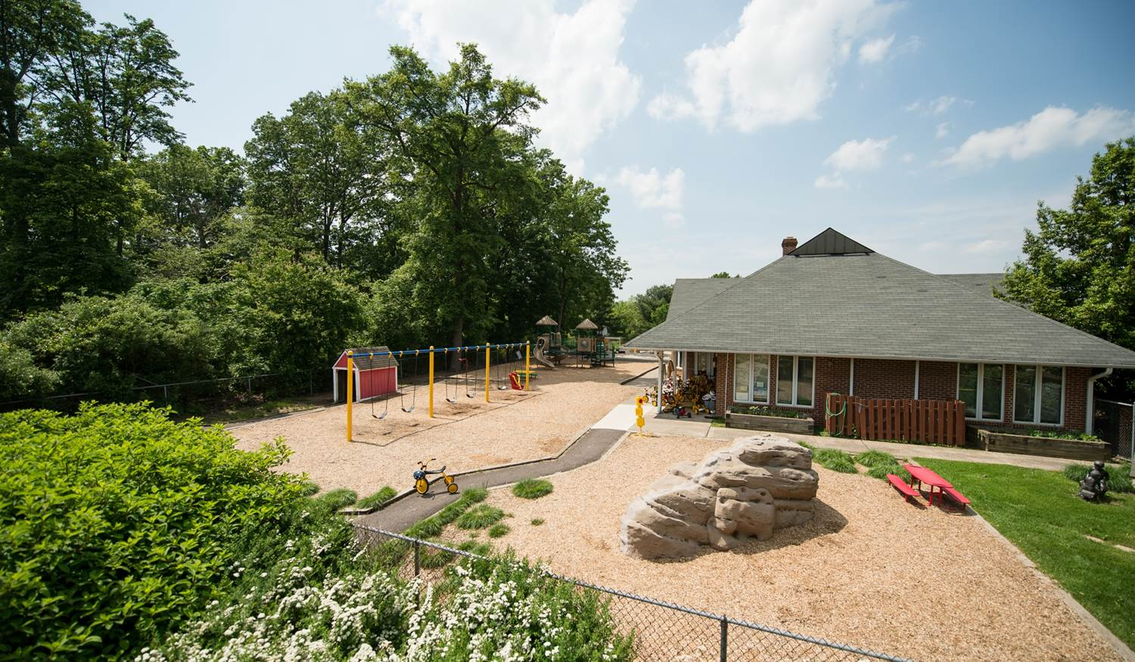
Our modern facility offers state-of-the-art indoor and outdoor play spaces, equipment and learning areas.

Slide 4

We understand that happy children make happy learners. Our play-based early childhood center offers programs tailored to babies, toddlers and young children.

Slide 5

Our infant-toddler program provides a loving “home away from home” for our youngest learners. Your little ones feel special thanks to our nurturing, certified caregivers who happily offer lots of holding, rocking, singing, reading and cuddling.

Slide 6
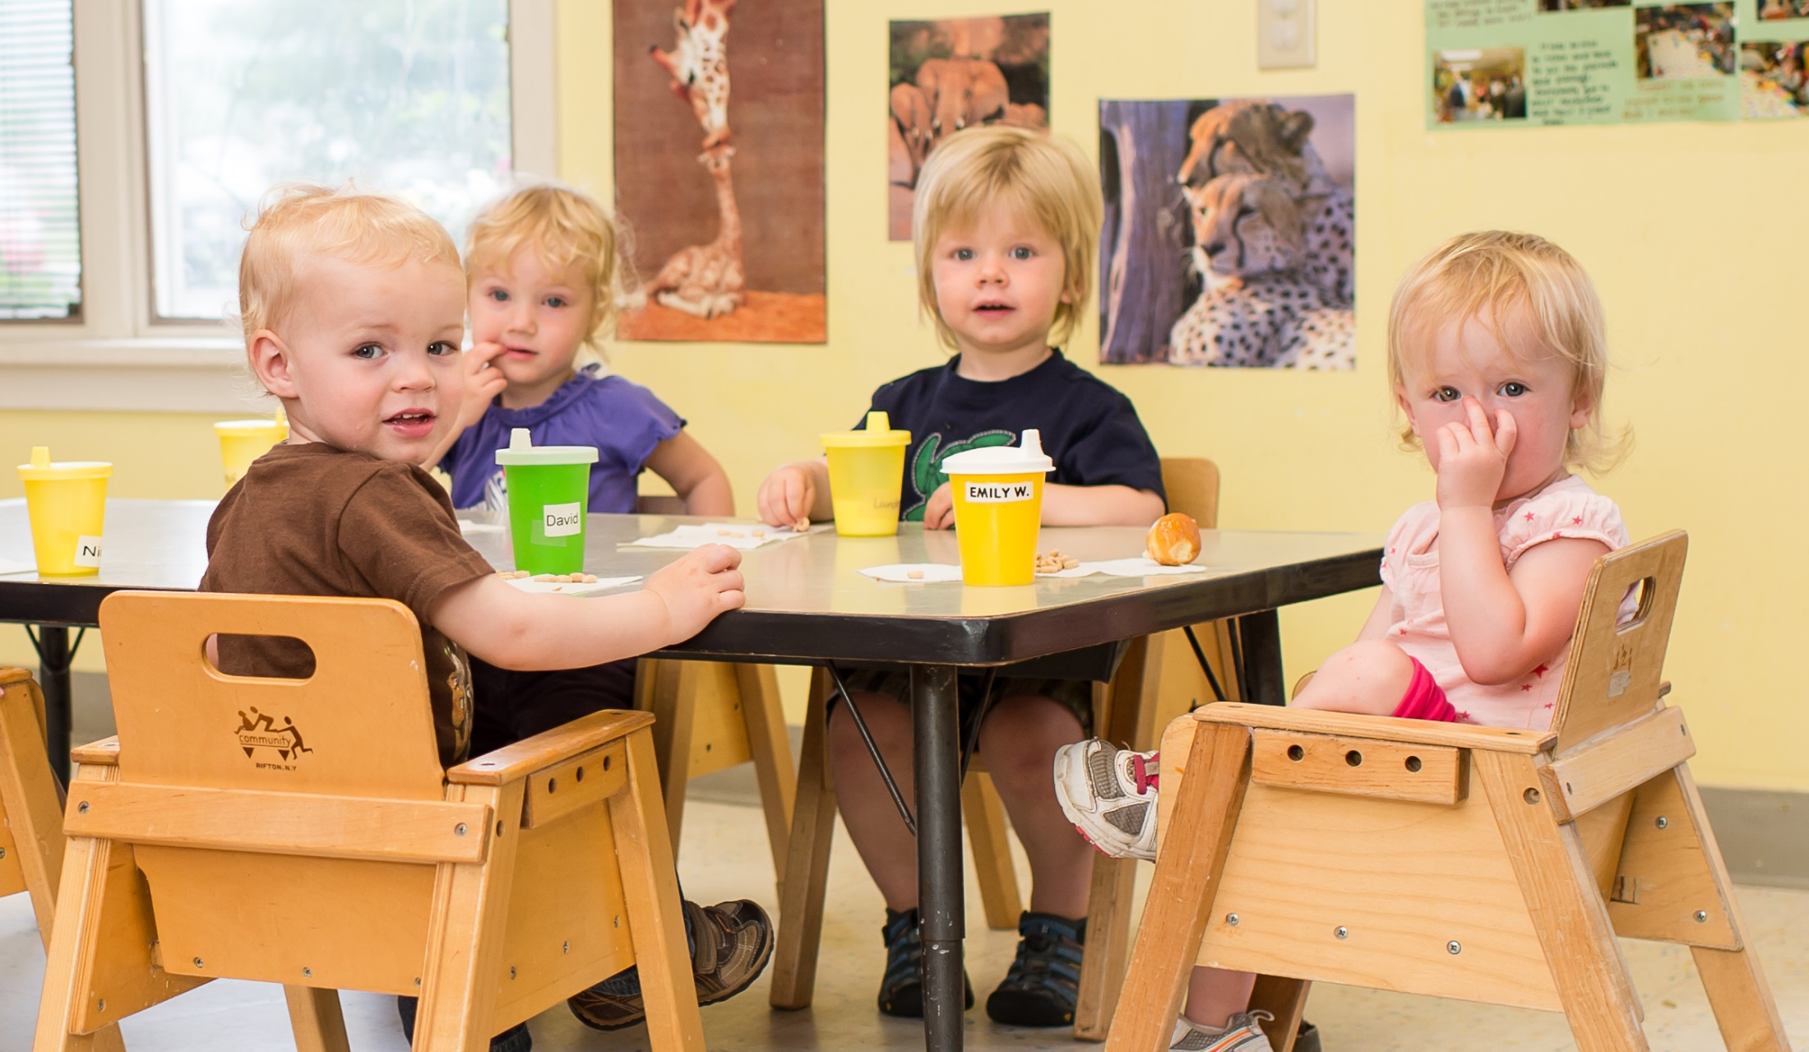
We customize schedules for feeding, napping and activities by regularly consulting with parents and caregivers in order to promote healthy eating and sleeping habits.

Slide 7
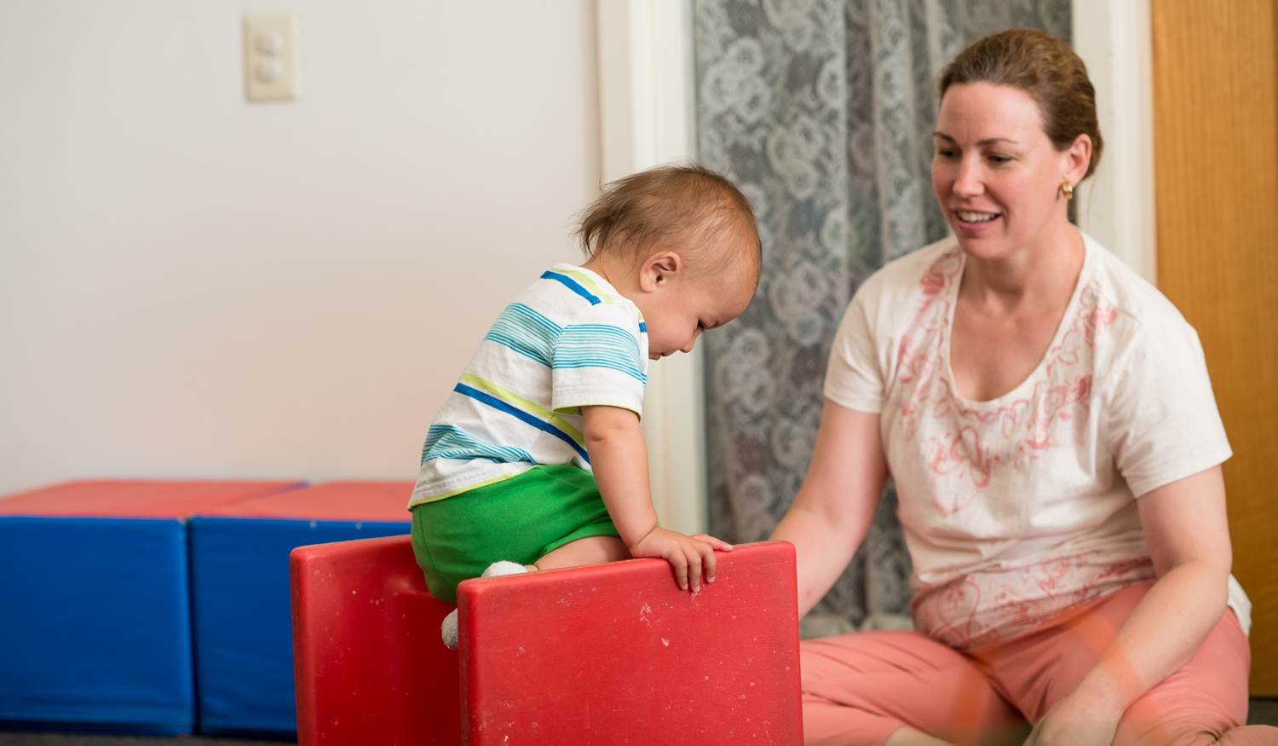
Your child will receive personal attention from our nurturing caregivers. We’ll be sure to celebrate special milestones like following simple directions, learning about the potty, dressing and undressing or meeting new friends.

Slide 8
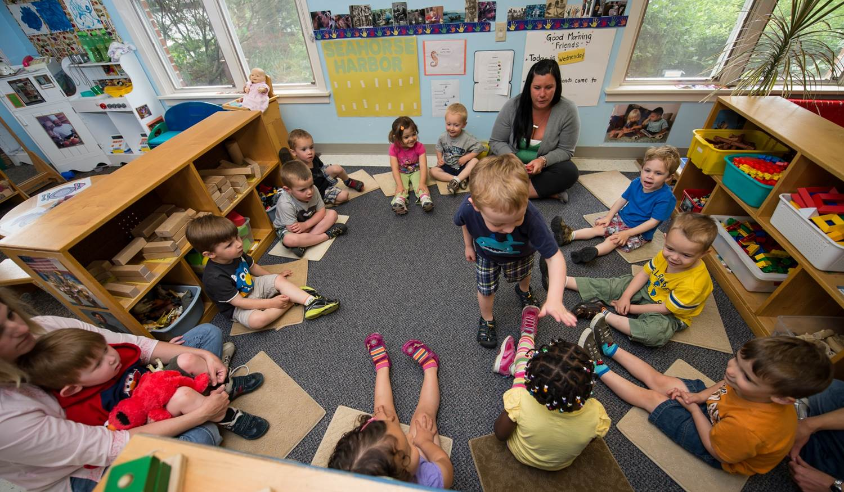
Our preschool program is tailored to meet each family’s need. We offer traditional preschool hours from 9 am to noon, and partial-day or full-day care for families with a need for child care services.

Slide 9
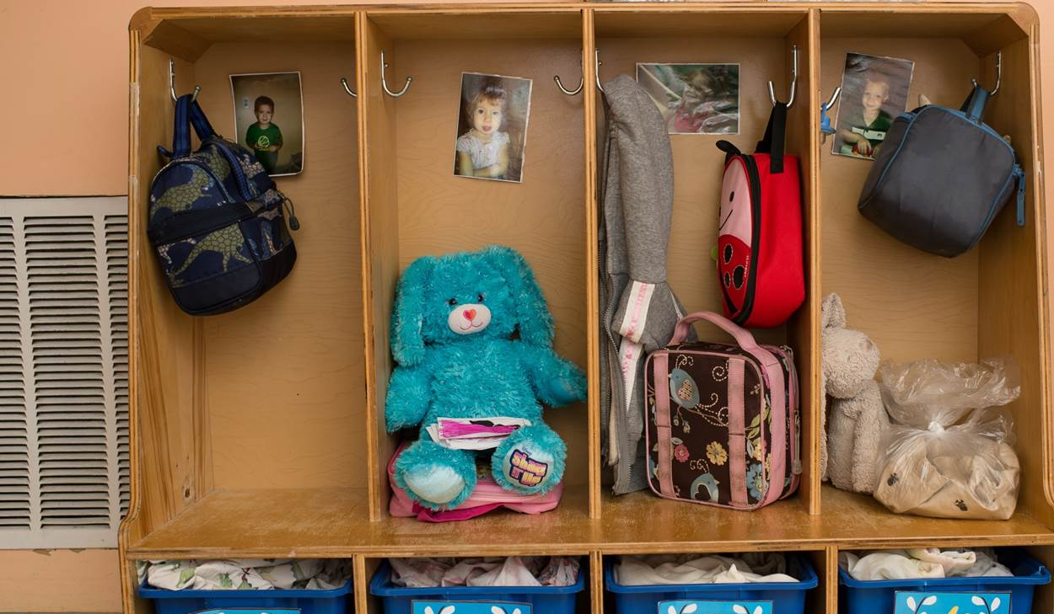
We encourage children to develop greater independence by washing hands, dressing, cleaning up after meals and storing toys after playtime. Children also learn to follow directions and to play nicely with friends.

Slide 10
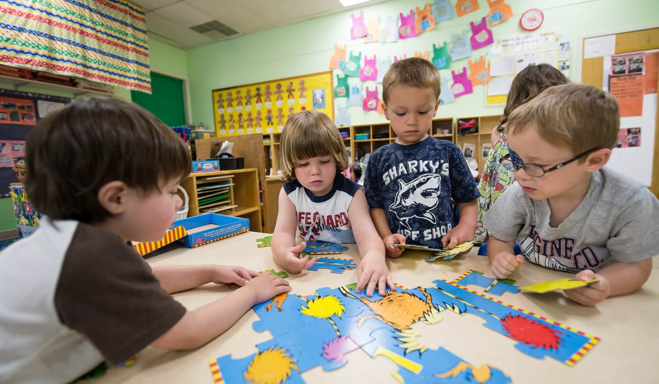
Children start learning letters and numbers with songs, dramatic play, stories and individual and group art experiences. We also encourage decision-making abilities through “choice time” which allows your child to plan their play activities for the day.

Slide 11
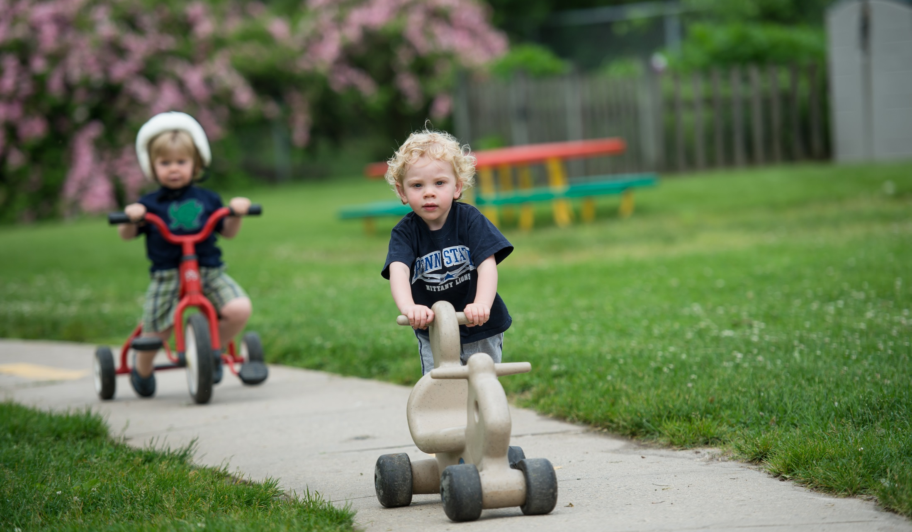
Our preschool program allows your children plenty of time to play outside on a variety of playground equipment, bikes and in our garden, and includes water-play in the summer.

Slide 12
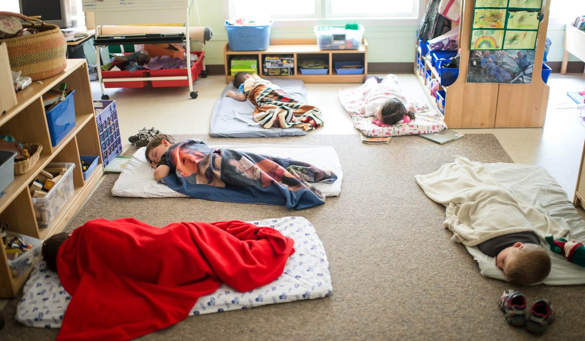
Rest is important. After lunch, bathroom and book time, napping is encouraged. Children who no longer nap may lie quietly on mats and read books. Children who are arriving during rest time may play quietly at the tables.

Slide 13
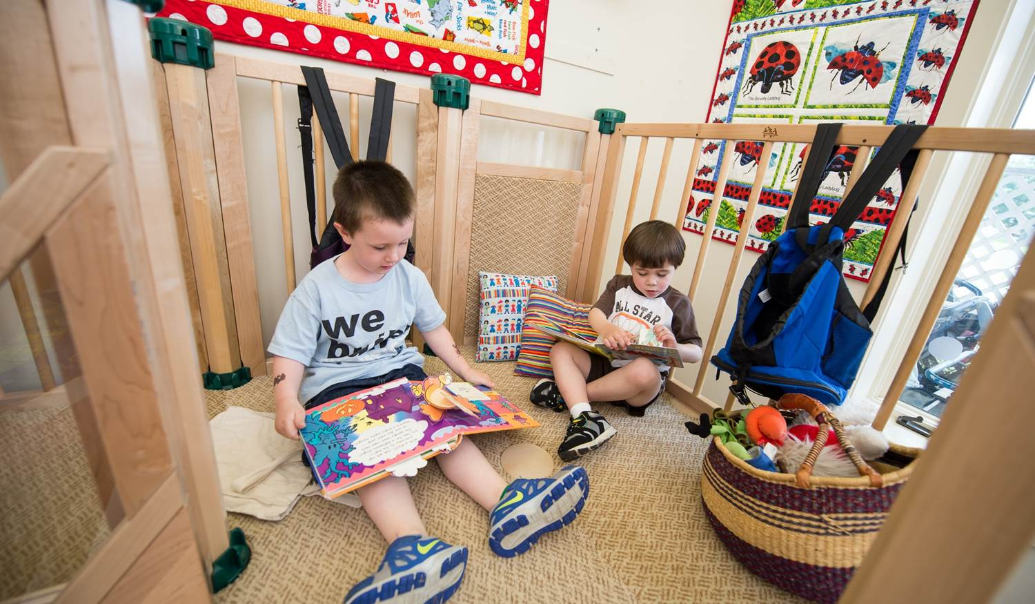
Our Pre-kindergarten program for children age 4 encourages literacy, numeracy, pre-writing skills, science and social studies exploration through projects and play-based experiences.

Slide 14
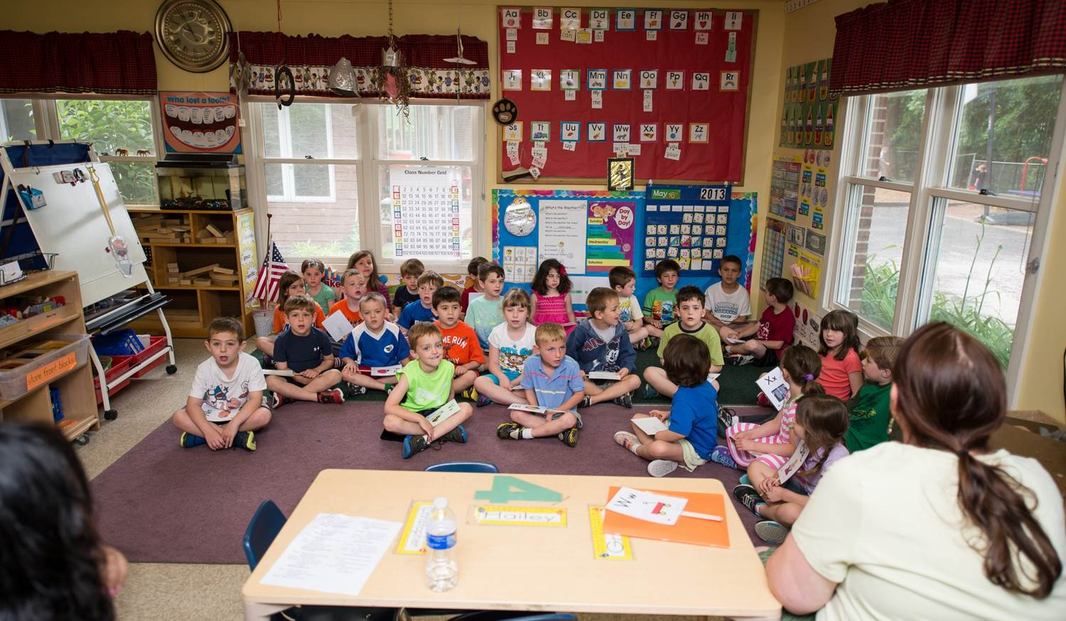
We help children prepare for kindergarten by helping them learn how to listen, how to play well with other children and how to be an eager learner. Our modern center includes computers in all preschool, pre-kindergarten and kindergarten classrooms.

Slide 15
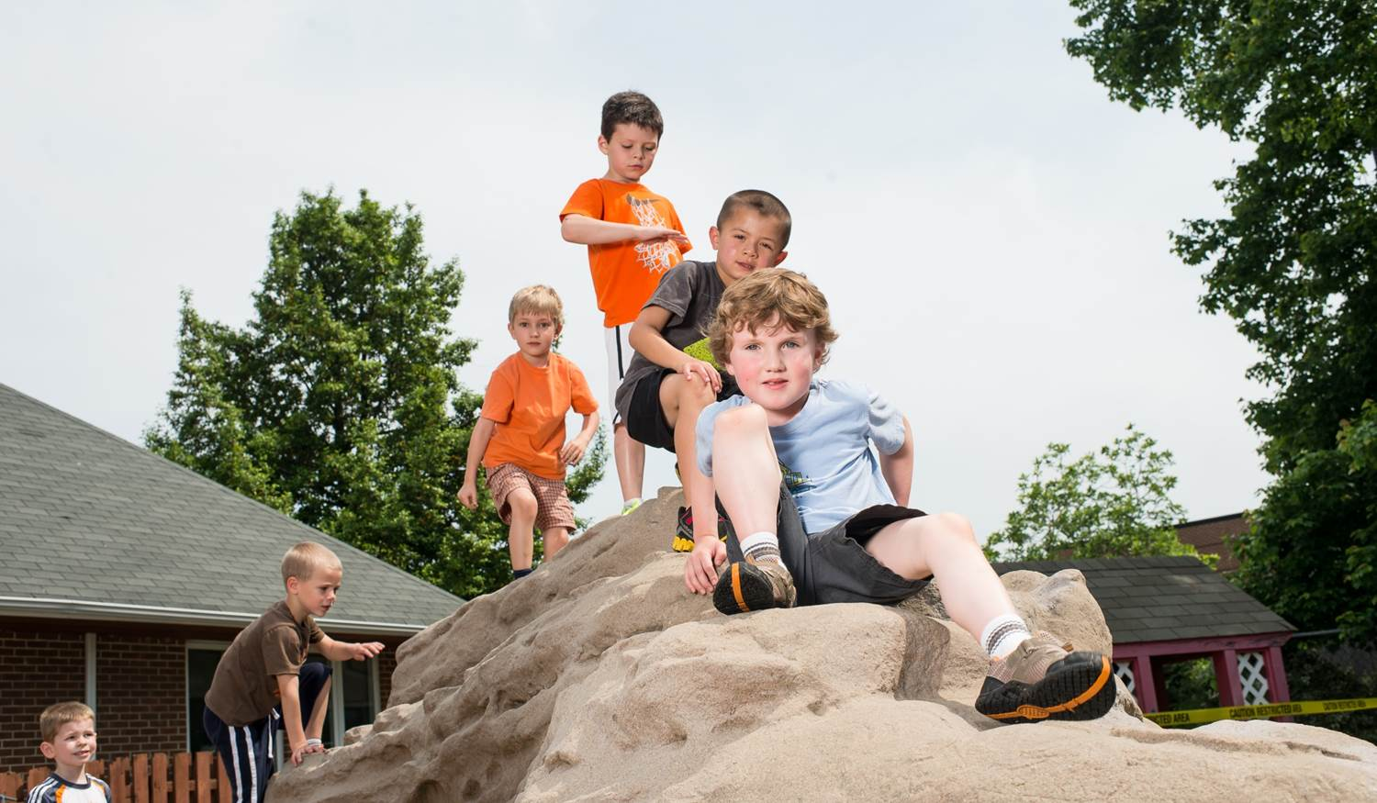
Children play and learn through creative activities like growing tomatoes and herbs for homemade pizza, climbing our “rock,” visiting our duck pond, touring the cafeteria at the hospital to learn about nutrition and hiking our nearby nature trails.

Slide 16

Children’s Village offers full-day kindergarten with before and after care included in tuition. Our kindergarten program is fun, educational and meets all national, state and local curriculum requirements.

Slide 17
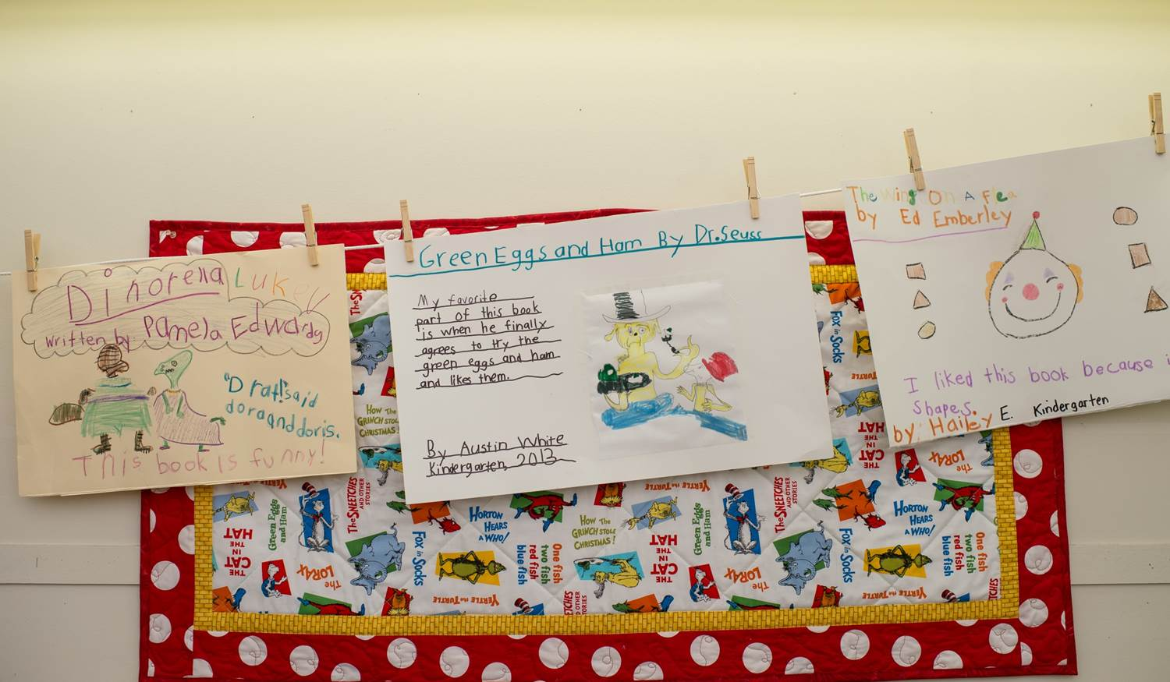
We match academic readiness with our continuing emphasis on finding joy and fun in learning each and every day. Our program includes many of the same programs used in the Central Bucks School District curriculum.

Slide 18

In addition to classroom learning, we ensure that your child experiences lots of exercise and outdoor playtime.

Slide 19
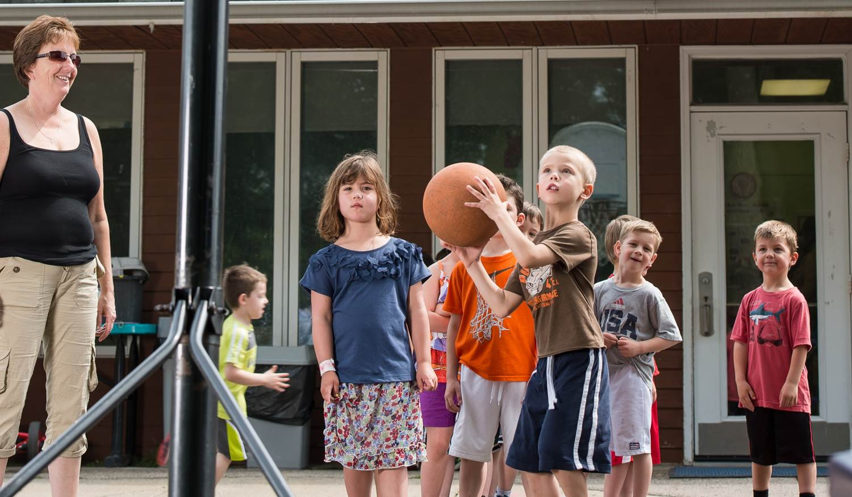
Children’s Village offers a large shaded outdoor play area for your child’s enjoyment. Here, children play games, make friends, and engage in outdoor adventures like climbing jungle gym “mountains” and hiking trails.

Slide 20
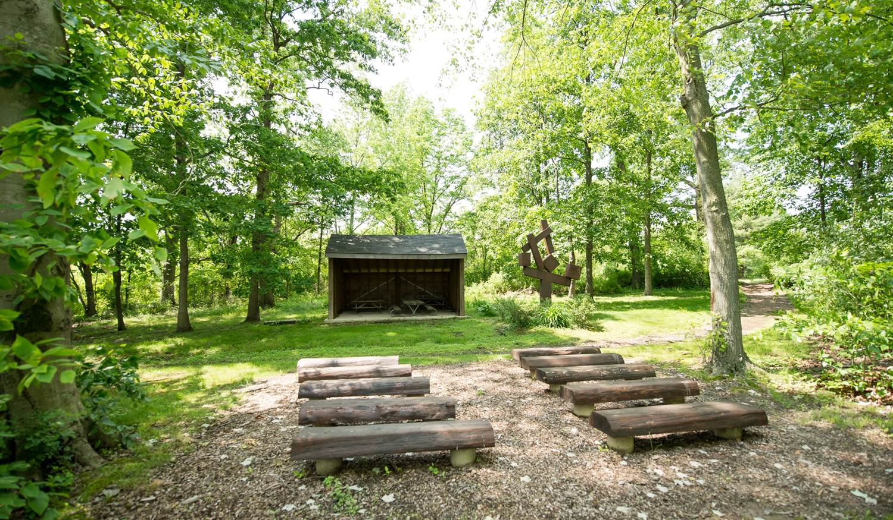
Our students also take advantage of learning in an outdoor classroom/amphitheater on the Doylestown Hospital campus.

Slide 21
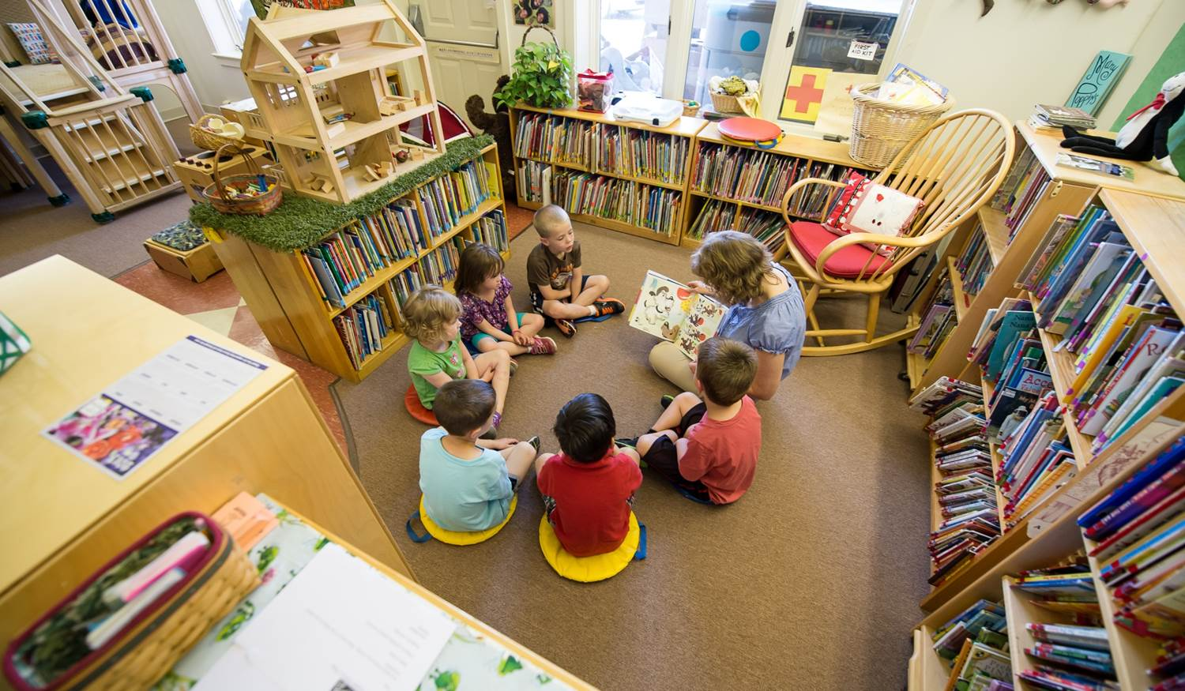
The Children’s Village library offers a cozy space where children read, tell stories, play, discover and imagine. Our full-time librarian helps students choose from more than 4,000 age-appropriate books and to encourage a love of reading.

Slide 22
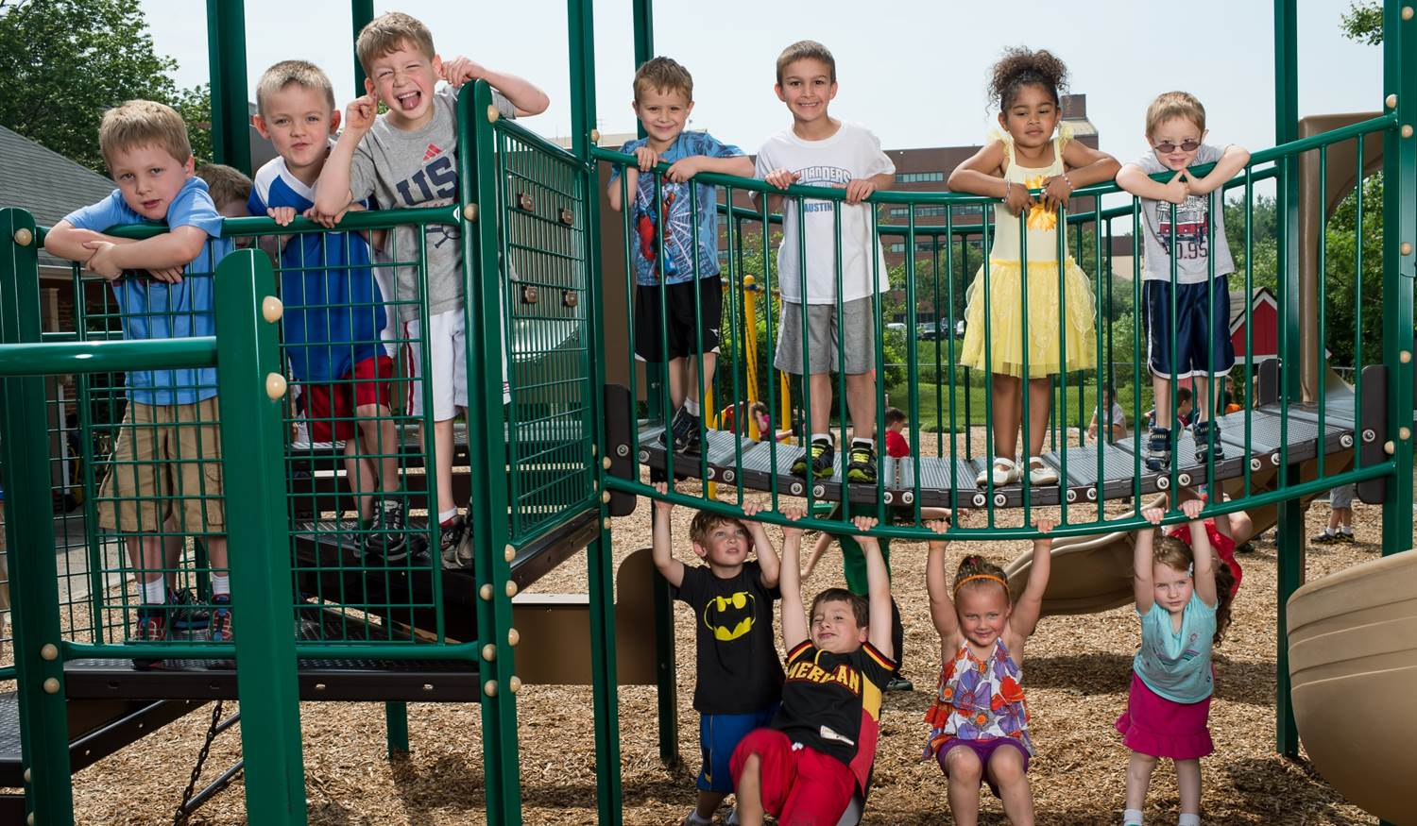
Children’s Village offers a summer program with fun outdoor activities like sprinklers, water tables, and wet sponge tosses. We also offer summer camp for older children that have graduated from Children’s Village.

Slide 23
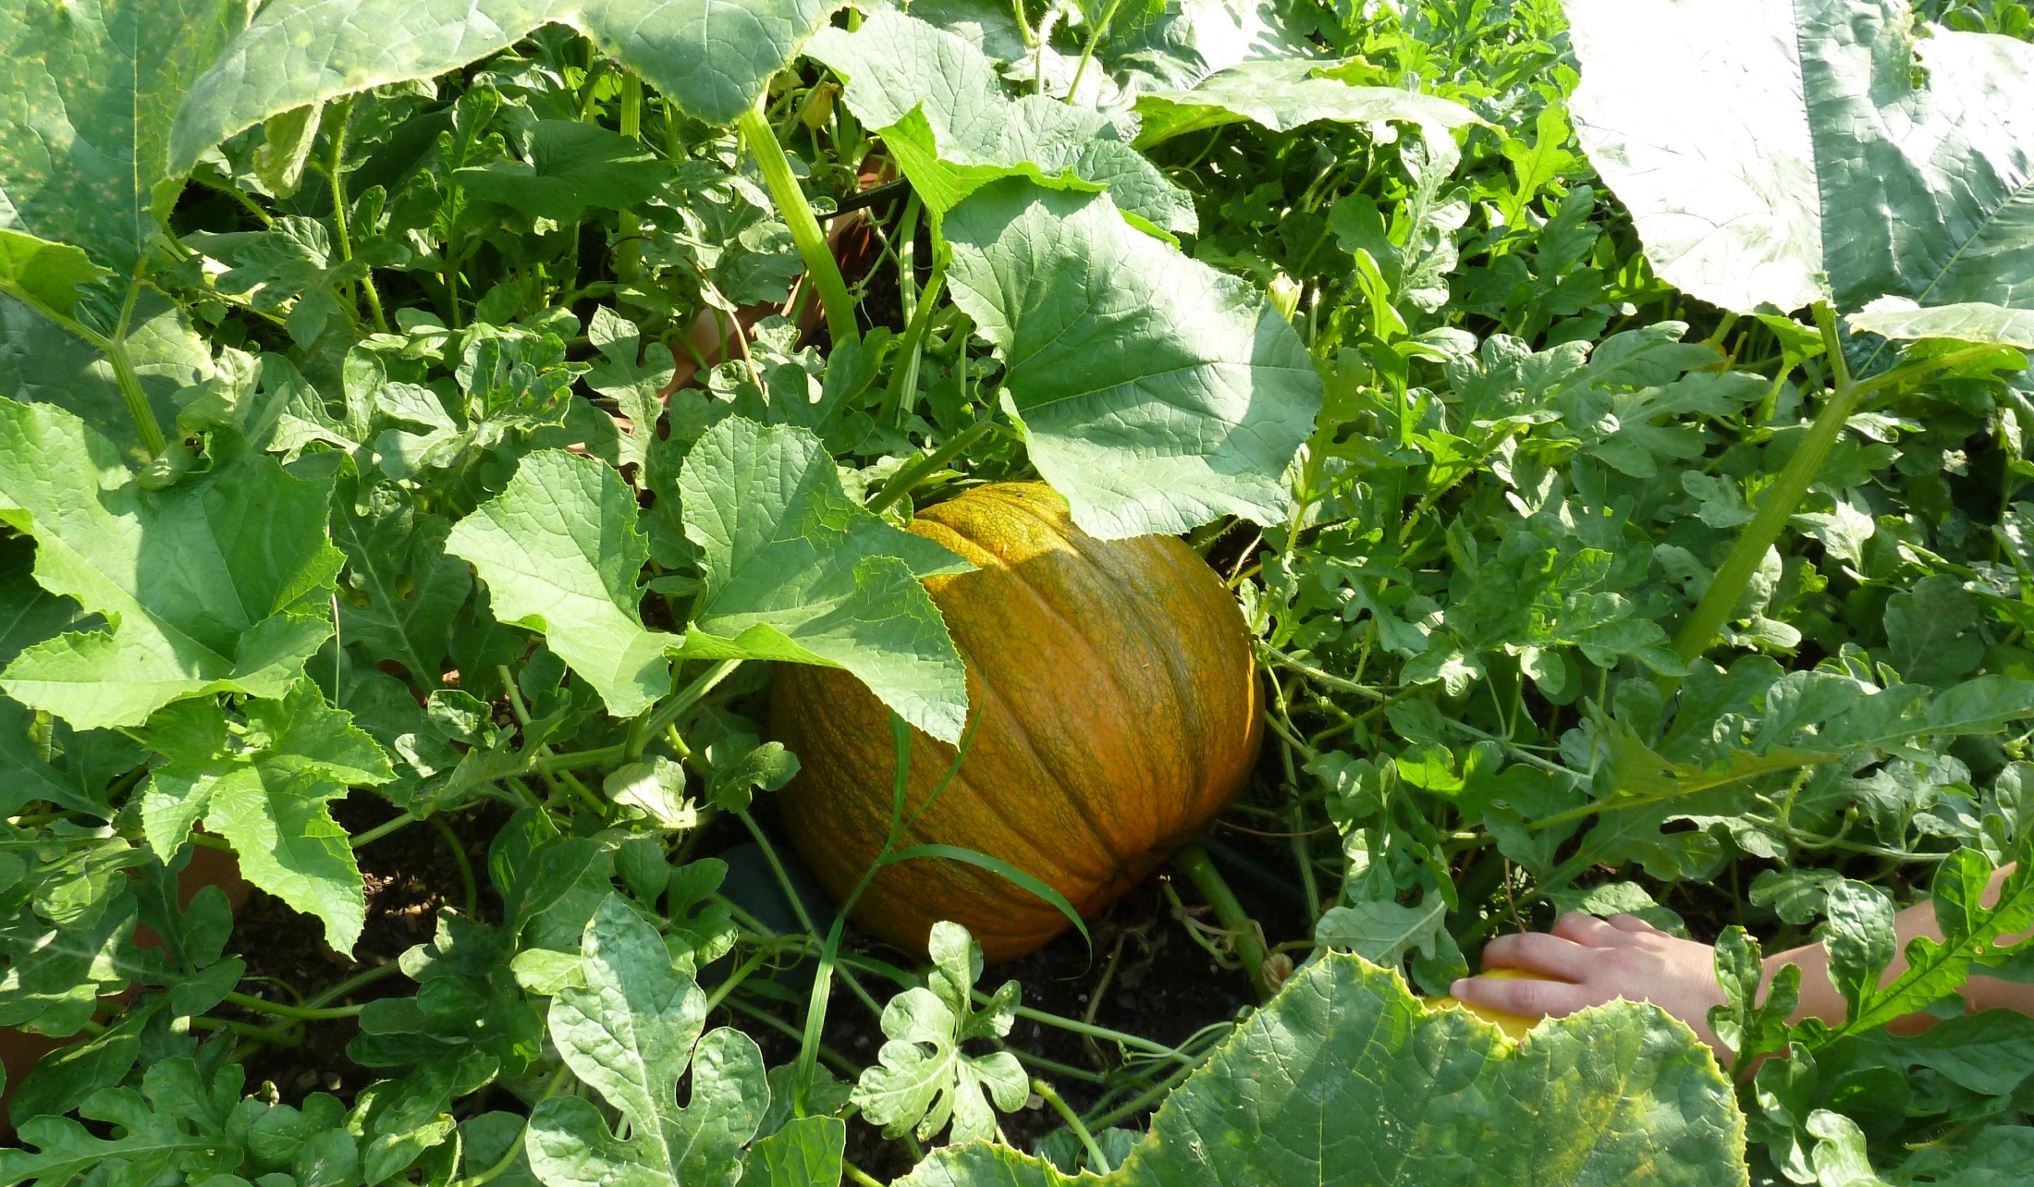
Children’s Village believes that the best learning occurs when children are actively involved with people and materials in their environment.

Slide 24
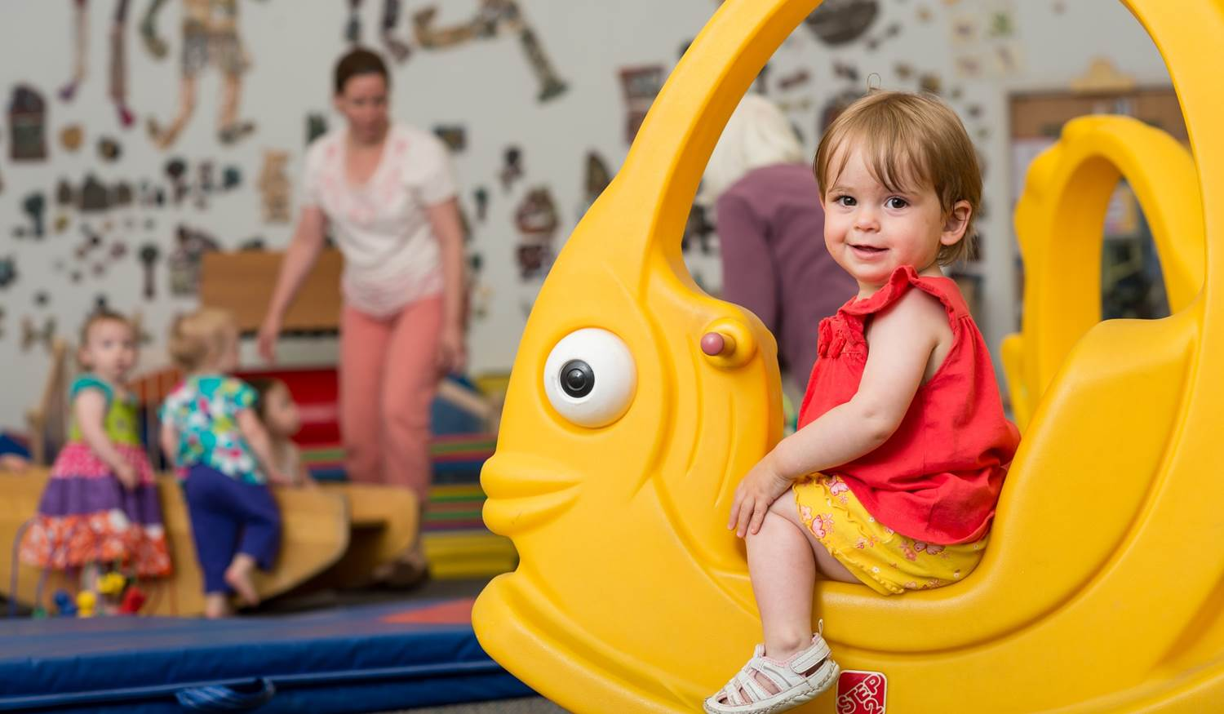
We are fully licensed and accredited by the National Association for the Education of Young Children (NAEYC), and both the Pennsylvania Department of Human Services and Department of Education.

Slide 25
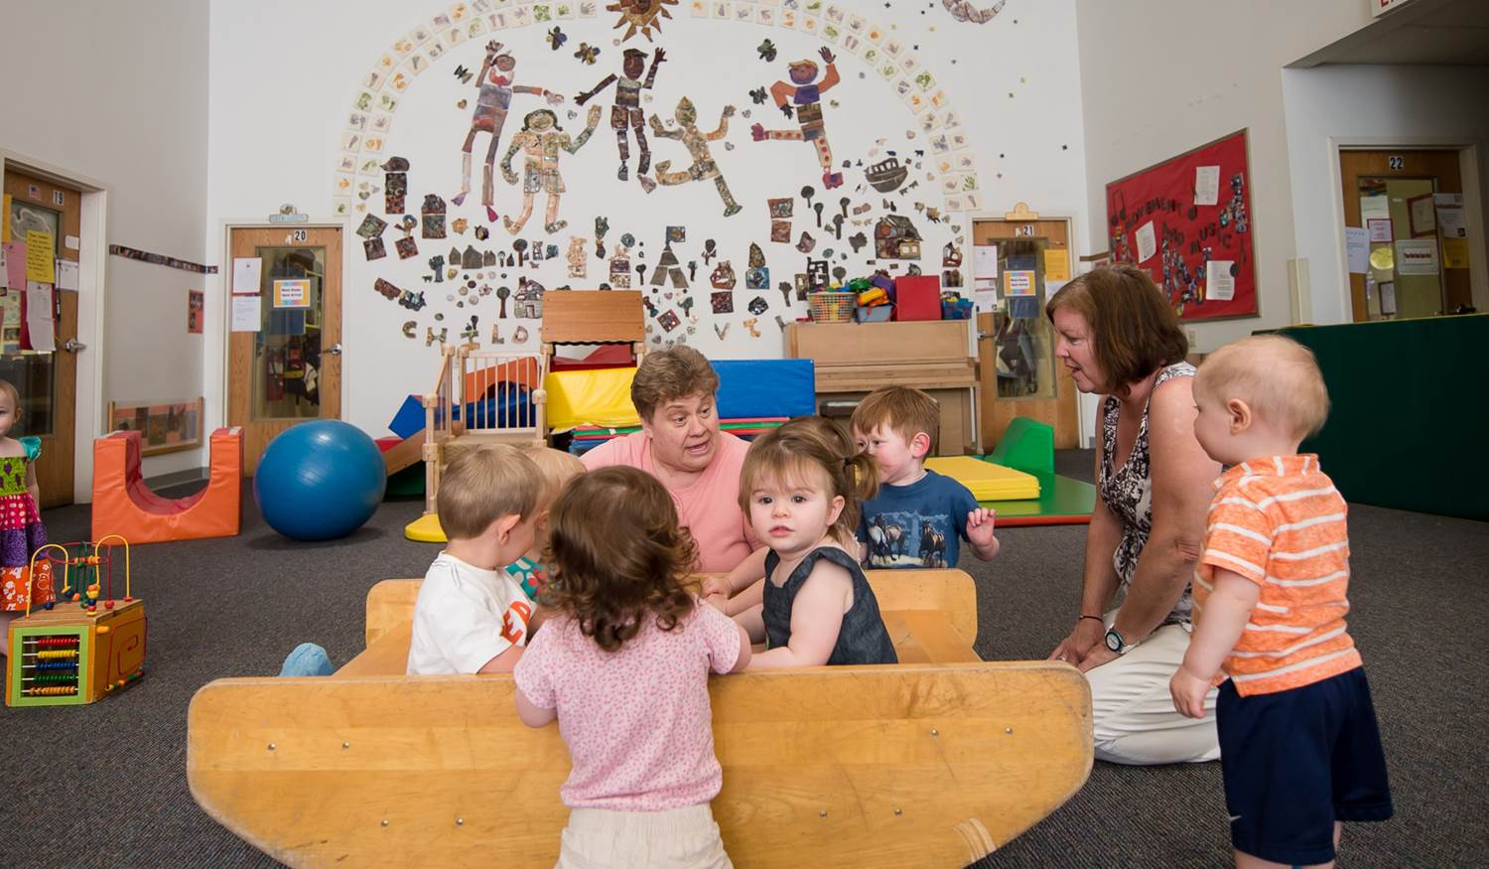
Our center also maintains a STAR-4 rating (the highest) in the Pennsylvania Keystone STARS Quality Initiative. Our highly qualified teaching specialists are certified in early childhood education and have completed related training such as CPR and First Aid.

Slide 26
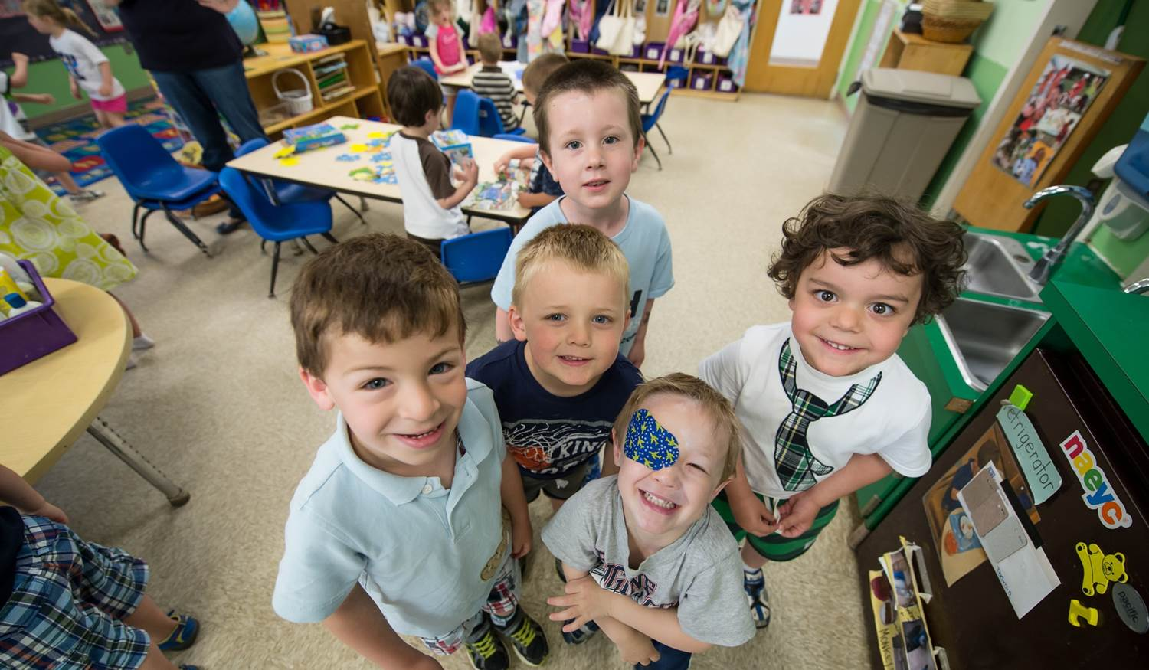
We foster a comprehensive learning environment and accept children with disabilities as well as non-English speaking children. We also work closely with Child Care Information Services of Philadelphia (CCIS) to help families in need of financial assistance.

Slide 27
For more information or to schedule a tour, call 215.345.2678 or email childrensvillage@dh.org.

